Slide 1
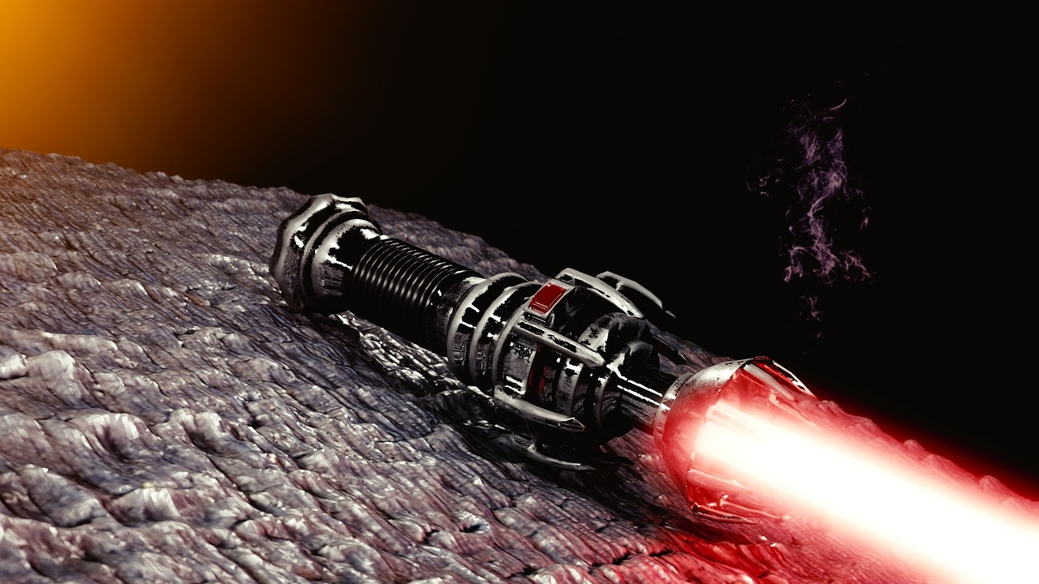
Sith Lightsabers
By Loz

Slide 2
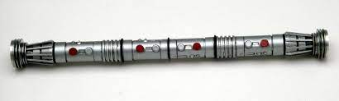
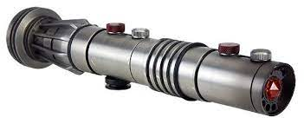
Darth Maul's 1st Lightsaber
Spins
Double Bladed
Cut in Half
Used as a single blade
Lost after battling Maul’s former master
Puts back together
Loses after a sky battle
Full lightsaber and not in half
Cut in half single blade

Slide 3
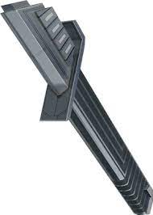
Darksaber
Stolen from Pre Vizla by Maul during duel
Used it to battle Sidious after Savage died
Recovered when Maul was defeated
Used to battle Dooku, Jedi (such as Kenobi), Sidious again, General Grievous, and Nightsister Spirits.
Left on Dathomir after Maul made a new Sith Saber
Ezra asks questions about it when Maul takes him to Dathomir and Sabine Wren possessed uses it to fight Ezra, Ezra gets it uses it, leaves it behind, and later Sabine Wren picks it up.
Falls into the hands of Bo Katan and Moff Gideon and finally then Din Djarin

Slide 4
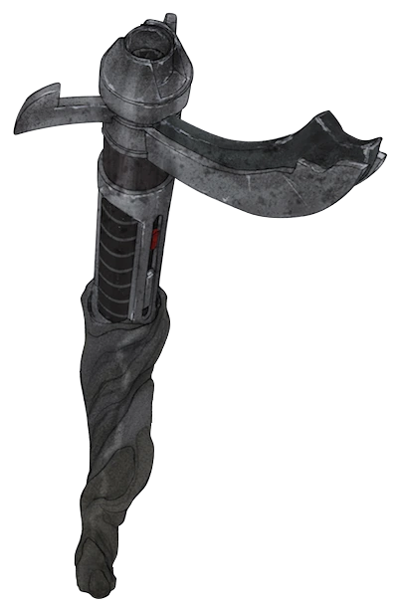
Darth Maul’s Second lightsaber
Built after order 66
Threatens people with it
Uses it as a cane and pretending like he is an old man
Maul uses it to fight inquisitors with Jedi Ahsoka Tano, Ezra Bridger, and Kanan Jarrus
Gets destroyed by Obi Wan Kenobi with his lightsaber cutting it in half.

Slide 5
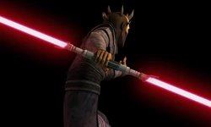
Savage Opress Lightsaber
Given to him by Dooku when under his apprenticeship
Used to fight Anakin and Obi Wan
Killed King Katunko with it
Battled Dooku with Asajj Ventress but had to leave
Went on search for his brother killed snake guy and junkers.
Battle Obi Wan with it and other Jedi even battled Maul.
Battle Pre Vizsla.
Fight Darth Sidious with Maul and lose eventually placed in Sidious’s office

Slide 6
Count Dooku's Lightsaber
Used

